Slide 1














Data & AI Solutions Experts

Slide 2
Agenda:
Access Control:
Solution overview for Access Control & Leaderboard
Access Management Options for Data in Fabric
Security Schema in Detail
Project Approach
Project Technical Architecture & Workstreams
Project Approach – Data Platform Development
Project Approach – Data Access Application
AI Ramp Up
AI Adoption – Stages
List of AI Use Cases

Slide 3

Solution overview for Access Control & Leaderboard
Individual Access is based on: Hierarchy, Domain, and Individual Exceptions
Inheritable Trait
Need Regional access because one reportee works out of Kuwait.
Developer Access
Write and Update
Data Lake & Warehouse – Full Access
Intermediate codes access.
Non Inheritable Trait
One reportee is a System Administrator. However, the trait should NOT be passed Heirarchically
Inherited
Should access because the team member is working on it.
User Group based
Access is given based on User Group: Role, Department, or Region.
Regional Head
Entire Region – Read Access Other Regions – Summary Access Other Business Units – No Access
Single Data Truth of Hierarchy needs to be established. The disjointed employees need to be identified and corrected.
NAME
Standard Groups are created. One individual may be a part of more than one group or no group.
Complete Access Profile
Individual Additional
Exceptional cases for Granting or revoking the access to specific elements.
Additional Responsibilities:
Taking up specific roles in an Individual capacity. Not attributable to a generic group.
Override: Override to otherwise granted access.

Slide 4
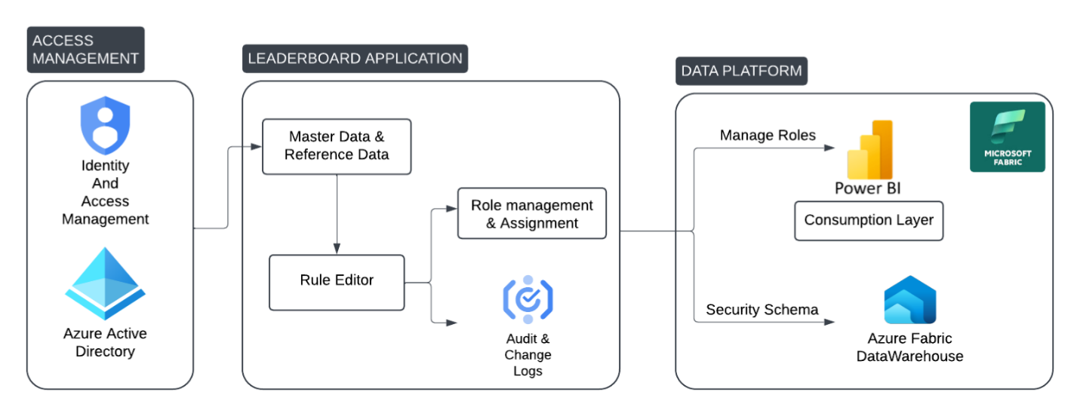
Access Management Options for Data in Fabric
Both Row and Column Level Access is deployable in Fabric.
Roles, Hieararchy, and Individual Overrides are applied here.
Flexible and Scaleable Architecture for Access Control
Outside Fabric Datawarehouse at Power BI using Manage Roles
Inside Fabric DataWarehouse using Security Schema.
Input User Information is taken from here.

Slide 5
Security Schema in Detail (Reference example only)
Both Row and Column Level Access is deployable in Fabric.
/*Create the security predicate defined as an inline table-valued function. A predicate evaluates to true (1) or false (0). This security predicate returns 1, meaning a row is accessible, when a row in the SalesRep column is the same as the user
executing the query.*/
--Create a function to evaluate who is querying the table
CREATE FUNCTION rls.fn_securitypredicate(@SalesRep AS VARCHAR(60))
RETURNS TABLE
WITH
AS SCHEMABINDING
RETURN SELECT 1 AS fn_securitypredicate_result
WHERE @SalesRep = USER_NAME();
DENY SELECT on dbo.Sales to USER_NAME(); GO
/*Create a security policy to invoke and enforce the function each time a query is run on the Sales table.
The security policy has a filter predicate that silently filters the rows available to
read operations (SELECT, UPDATE, and DELETE). */
CREATE SECURITY POLICY SalesFilter
ADD FILTER PREDICATE rls.fn_securitypredicate(SalesRep)
ON dbo.Sales
WITH (STATE = ON);
GO
Create the Security Policy
Bind the policy with the Database object

Slide 6
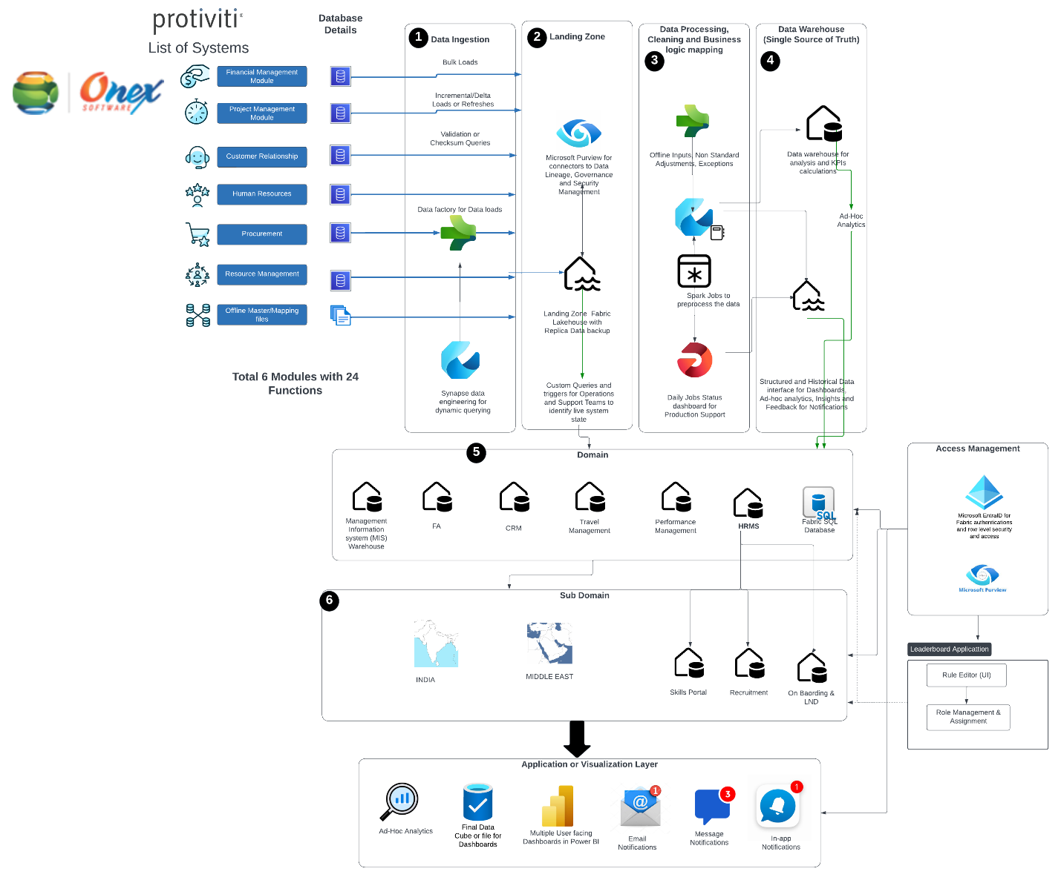
Project Technical Architecture & Workstreams
Project Stream 1: Data Platform Development
Project Stream 2: Access Management System and Application

Slide 7
Project Approach – Data Platform Development
Sprint Title | Objective | Priority | Feasibility | Under Development | In Review | Done
Existing 6 Dashboards Connectivity | Establish connectivity for dashboards related to Projects and Opportunities, including Historical MIS data.
Project Economics – Formula Revamp | Redesign and implement formulas for Project Economics.
MIS Dashboard Development | Build and revamp the MIS dashboard for consolidated reporting.
CRM + Business Plan + Travel Management Integration | Integrate CRM, business planning, and travel management modules.
HRMS – Profile Lifecycle and Resource Planning | Integrate HRMS for employee lifecycle and resource planning.
Performance Management | Implement performance management reporting.
FA Module Reporting | Develop reporting solutions for the FA module.
Skills Portal | Implement a Skills Portal for tracking and managing employee skills.
Recruitment + Onboarding + L&D | Build modules for recruitment, onboarding, and learning & development processes.

Slide 8
Project Approach – Data Access Application
Sprint Title | Objective | Priority | Feasibility | Under Development | In Review | Done
Role-Based Access Control (RBAC) | Implement access management based on user roles and organizational hierarchy.
Row-Level Security (RLS) | Restrict data visibility based on user roles and responsibilities.
Column-Level Security (CLS) | Ensure sensitive fields are accessible only to authorized users.
Dynamic Access Rules | Automate access rights allocation based on job changes, promotions, and team transfers.
Business Group Access | Enable group-based access control for cross-functional collaboration.
Leaderboard Management | Provide an overview of access levels and privileges for different stakeholders.
Audit & Logging | Monitor access requests, changes, and security breaches.
Access Request Workflow | Enable users to request and approve access dynamically.
Integration with Microsoft Purview | Ensure governance and compliance with security policies.

Slide 9
AI Adoption - Stages
Feature/Aspect | Fabric Copilot | Copilot Chat | Copilot Studio | Azure AI Services (Foundry)
Primary Purpose | Data analytics and business intelligence | Conversational AI for applications | Custom AI app development | Building and deploying AI/ML models
Integration with Microsoft Tools | Deep integration with Microsoft Fabric | Integrated into Microsoft 365 apps | Integrated with Azure DevOps, GitHub | Integrated with Azure ecosystem
Key Capabilities | Data analysis, predictive insights | Real-time Q&A, contextual chat | Low-code/no-code AI app creation | Custom AI model training, deployment
Customization | Moderate customization | Limited to conversation flows | High customization, custom models | Full customization of AI/ML models
User Interface | Power BI-like dashboards | Chat-based interface | Visual interface for app building | API-driven, coding environment
Data Handling | Works with Microsoft Fabric data | Uses context from integrated apps | Can access Azure data services | Supports various data sources via Azure
AI Model Control | Pre-built models, minimal tweaking | Pre-built conversational models | Custom models, pre-trained options | Custom model training and deployment
Typical Use Cases | Data exploration, insights generation | Customer support, information lookup | Building AI-driven applications | Predictive modelling, custom AI development
Deployment Flexibility | Cloud-based within Microsoft ecosystem | Cloud-based | Cloud and on-premises options | Cloud, on-premises, or hybrid deployment
Ease of Use | User-friendly, requires minimal AI knowledge | Easy for end-users | Designed for ease of use by developers | Requires AI/ML expertise
Cost Structure | Based on Microsoft Fabric subscription | Tied to Microsoft 365 subscriptions | Azure consumption-based pricing | Pay-as-you-go or reserved capacity in Azure
Limitations | Limited to Microsoft Fabric ecosystem. Less control over AI models | Restricted to pre-defined conversation models; limited outside Microsoft 365 apps | Requires Azure knowledge, complex for non-developers | Requires significant AI/ML expertise, higher costs for large-scale deployments

Slide 10
List of AI Use Cases
Name | Description
Use of Co-Pilot - Access Management and Workspace concept implementation. | Can be used for Predictive and prescriptive models - Ad hoc Analysis - Exploratory Data Analysis Use different Co-Pilot AI Workspaces for various functions and working groups - The Operations team, MIS, Developers etc. Only Published version will have applied Operational Guidelines.
AI and Data Science Workspaces by Individual Protiviti Solutions (D&D, IAFA, TC etc.) | Individual Solutions to have their own data exclusively in a controlled workspace of their, available for them for Analysis using Co-pilots and paly with AI features offered by Fabric for their Analytics. This will be separate from Co-Pilot workspace used for Operational benefits at Organization level, for which CXOs and Senior MDs have access to. To enable this Workspace and Entra ID ( Row and Column based) access management required using Groups ,Roles assigned to Group ( and not individuals).
Data Architecture Principle for AI - Applicable Enterprise wide | ERP is Data of Source only. Data Platform is Single Source of Truth for all Data, Analytics and AI applications.
Protipedia Knowledge Management | a. How to use Microsoft Fabric for registering the Project Knowledge and Data in Protipedia for answering project related queries around EFPs, proposals, deliverables, Milestones etc. ? b. How to write prompts for Copilot ?
Automation of Travel Vendor Invoices Management | a. When we are creating a Travel (BTF - Travel form) used for creating Accrual per day. b. Streamlining the Operation of matching validating Vendor invoices line items in a monthly statement with BTF Accrual forms, created one per day in Manual and time consuming task. Validation is a error prone process with no strong matching identifiers but plain text fields like Names of employees and Vendors names. c. Also facilitate claims by Employees and their reimbursement of tickets and other travel related services if booked by Employees themselves. This use case is to automate match and mark the Vendor invoices line items for payment, using MS Fabric and Copilot.
Protipedia - Develop new Proposal development from existing Proposals | a. Challenge with Protipedia on Drupal framework and S3 infrastructure - Search engine is nascent and not able to search through the content effectively. b. Data and content in Protipedia is rich. Map Copilot to Protipedia Blob Storage buckets data lake and extract, generate proposals for a class of proposals from unstructured data in the existing proposals. a. Need to extract and compile Metadata of all project proposals. b. Need for labelling and tagging the content of all the project proposals c. Build MS Fabric and Copilot AI interface to Protipedia data
Use Protipedia for Project related queries | Instead of Google and ChatGPT for Project information, help us configure Copilot to use Protipedia in its current for. Note: Not to recreate Protipedia in MS Fabric repository as it need extra budget and time
Predictive Models for Opportunity KPIs | a. Review and implement win or lose approximation models of Opportunities that were developed in the past, as feasible b. Generate KPIs on a daily basis, that will impact performance of Sales people involved.
Project Economics | Shared a data file - Project having: a. What kind of queries we can ask and fabric can return answers

Slide 11



Contact Details
www.softsensor.ai
softsensor.ai
sales@softsensor.ai

